Slide 1
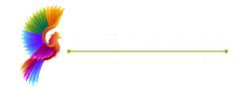

NEXTHIKE IT SOLUTIONS
Python-Powered GUI Calculator
This visually polished and functionally robust calculator application was developed using the Python programming language and the Tkinter GUI toolkit. It provides users with an intuitive interface to perform essential mathematical computations.
Mr. Aniket G. Tayade.

Slide 2
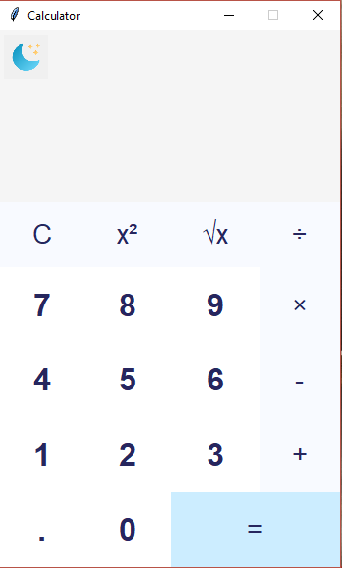
A Snapshot of Functionality
Input Area
Button Panel
Display Area
A designated area for entering numbers and operators.
A well-organized panel of buttons for numbers, operators, and functions.
A clear display to show the entered expression and calculation results.

Slide 3

Core Operations
1
Addition (+)
2
Subtraction (-)
Add two or more numbers together.
Subtract one number from another.
3
Multiplication (*)
4
Division (/)
Multiply two or more numbers.
Divide one number by another.

Slide 4
Sr.No | Challenges | Solutions
1 | Designing the UI Layout | Used Tkinter's Frame, Label, and Button widgets to structure the layout properly. Used grid() and pack() for better placement.
2 | Button Click Event Handling | Implemented event-driven programming using Tkinter’s command parameter in Button widgets to handle user inputs dynamically.
3 | Displaying and Updating Input Values | Used StringVar() to bind input values to the Entry widget and update them dynamically when a user presses buttons.
4 | Handling Mathematical Operations | Used Python’s eval() function to compute expressions, ensuring input validation to prevent errors or security risks.
5 | Managing Division by Zero Error | Implemented error handling using try-except to catch division by zero and display an appropriate message.
6 | Handling Keyboard Input | Implemented bind() method to allow users to input numbers and operators using the keyboard.
7 | Implementing Light and Dark Theme | Added a toggle button that switches between light and dark themes by changing the background color (bg), foreground color (fg), and button styles dynamically using a function.

Slide 5




References and Links
Python Documentation
Open Source Projects
Websites
https://docs.python.org/3/library/tkinter.html
https://www.geeksforgeeks.org/python-simple-gui-calculator-using-tkinter/
https://www.ascii-code.com/

Slide 6
Sr. No. | Personal Satisfaction | Feature Choices
1 | The joy of tackling technical challenges and finding elegant solutions. | Essential arithmetic functions for everyday use.
2 | Exploring different design elements and creating a user-friendly interface. | Allows users to reset the calculator and start fresh.
3 | The satisfaction of building a working calculator that meets user needs. | Ensures robustness and prevents unexpected behavior.
4 | The enjoyment of enhancing user experience through customization. | Adds light and dark theme options in the Python calculator.

Slide 7

Thank You
I appreciate you taking the time to view this presentation and hope you enjoyed it.

